Slide 1
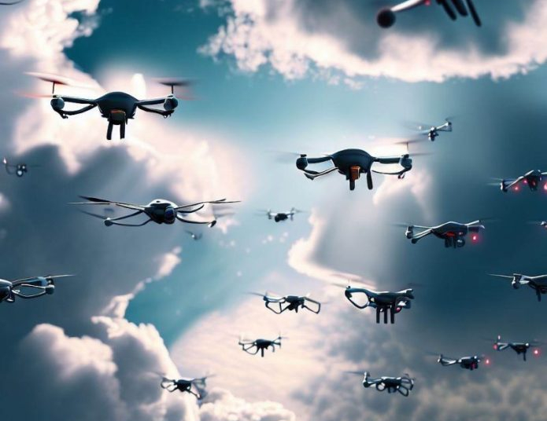

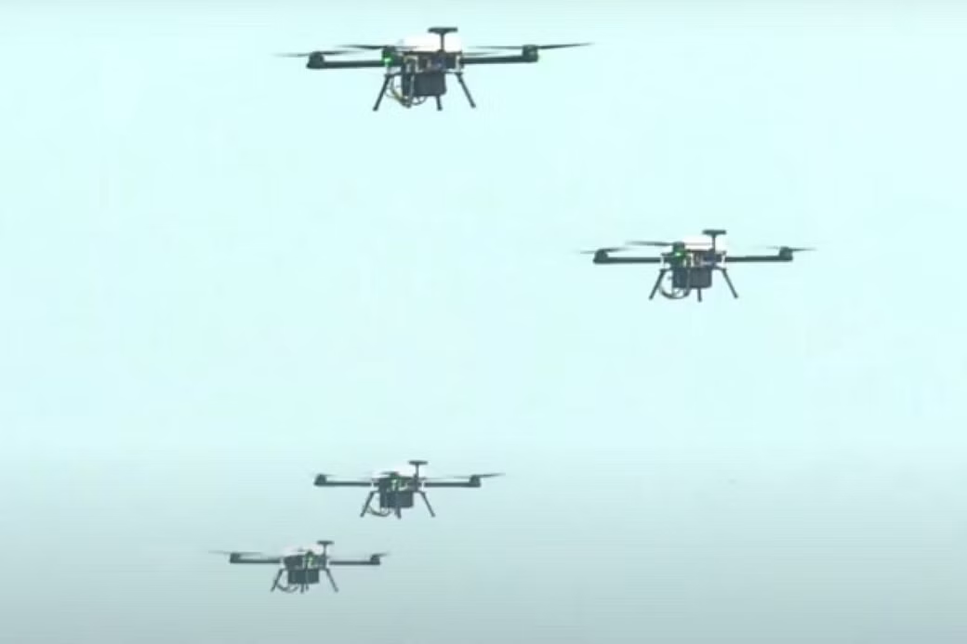
Swarm
Drones
Robofest 3.0

Slide 2
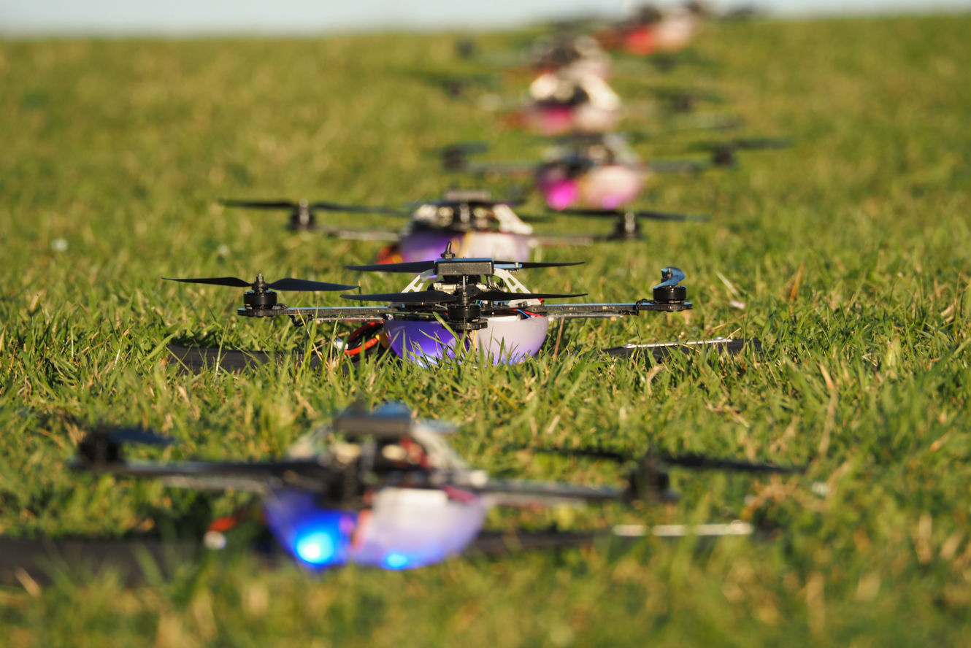
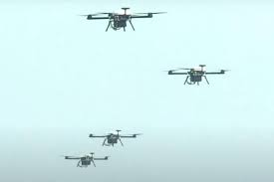
OVERVIEW
Swarm drones are a group of autonomous aerial vehicles that operate in a coordinated manner. They mimic the behavior of swarms found in nature, enabling them to perform complex tasks efficiently. This technology has immense potential in various industries, from package delivery to search and rescue missions.

Slide 3
About the project
01
Objectives
02
TABLE OF CONTENTS
System Architecture
03
The Swarm Algorithm
04
Major Components
05
Here you could describe the topic of the section
Here you could describe the topic of the section
Here you could describe the topic of the section
Here you could describe the topic of the section
Here you could describe the topic of the section

Slide 4
Software Used
06
Implementation
07
TABLE OF CONTENTS
Testing and Evaluation
08
Future Applications
09
End
10
Here you could describe the topic of the section
Here you could describe the topic of the section
Here you could describe the topic of the section
Here you could describe the topic of the section
Here you could describe the topic of the section

Slide 5
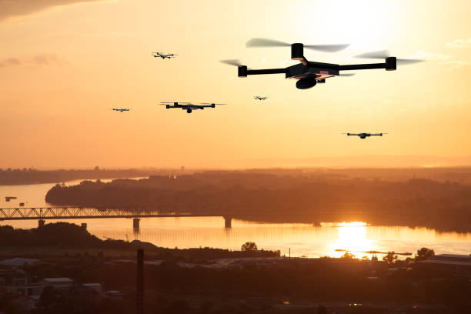
About the project
01

Slide 6
ABOUT THE PROJECT
This project aims to design and develop a group of aerial vehicles capable of coordinated motion without external controls. The primary objective is to enable the robots to move together in a synchronized manner, maintaining a predefined distance and direction, including forward, backward, left, and right movements over a range of 100 meters.
The system comprises 3 aerial robots, each equipped with flight controllers, communication modules (ESP8266), and control mechanisms. These robots are designed to operate as a unified swarm, with a central control unit acting as the master node responsible for distributing commands and facilitating coordination among the individual robots.

Slide 7
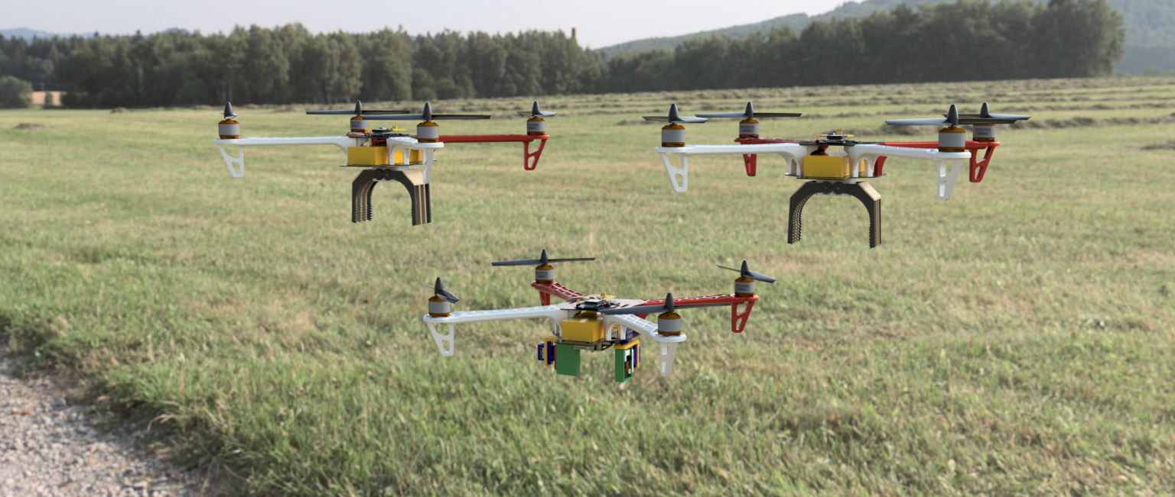
Objectives
02

Slide 8
PRIMARY GOAL
SECONDARY GOAL
WHAT WE ARE WORKING ON
AUTONOMOUS
DATA SYNC
To achieve coordinated motion, the robots employ advanced algorithms and techniques which we developed using libraries like dronekit and mavlink.
Ability to form 3 different shapes (circle, square, triangle). Should be able to pick plastic balls of a given colour, fly to a given destination and drop the ball in the cart.
The Swarm of Drones will accomplish the mission without relying on Ground Control. Instead, the drones will rely on calculated environmental data and sensor inputs to execute missions.
The data gathered by each drone will be shared and secured on the private server.

Slide 9

System Architecture
03

Slide 10
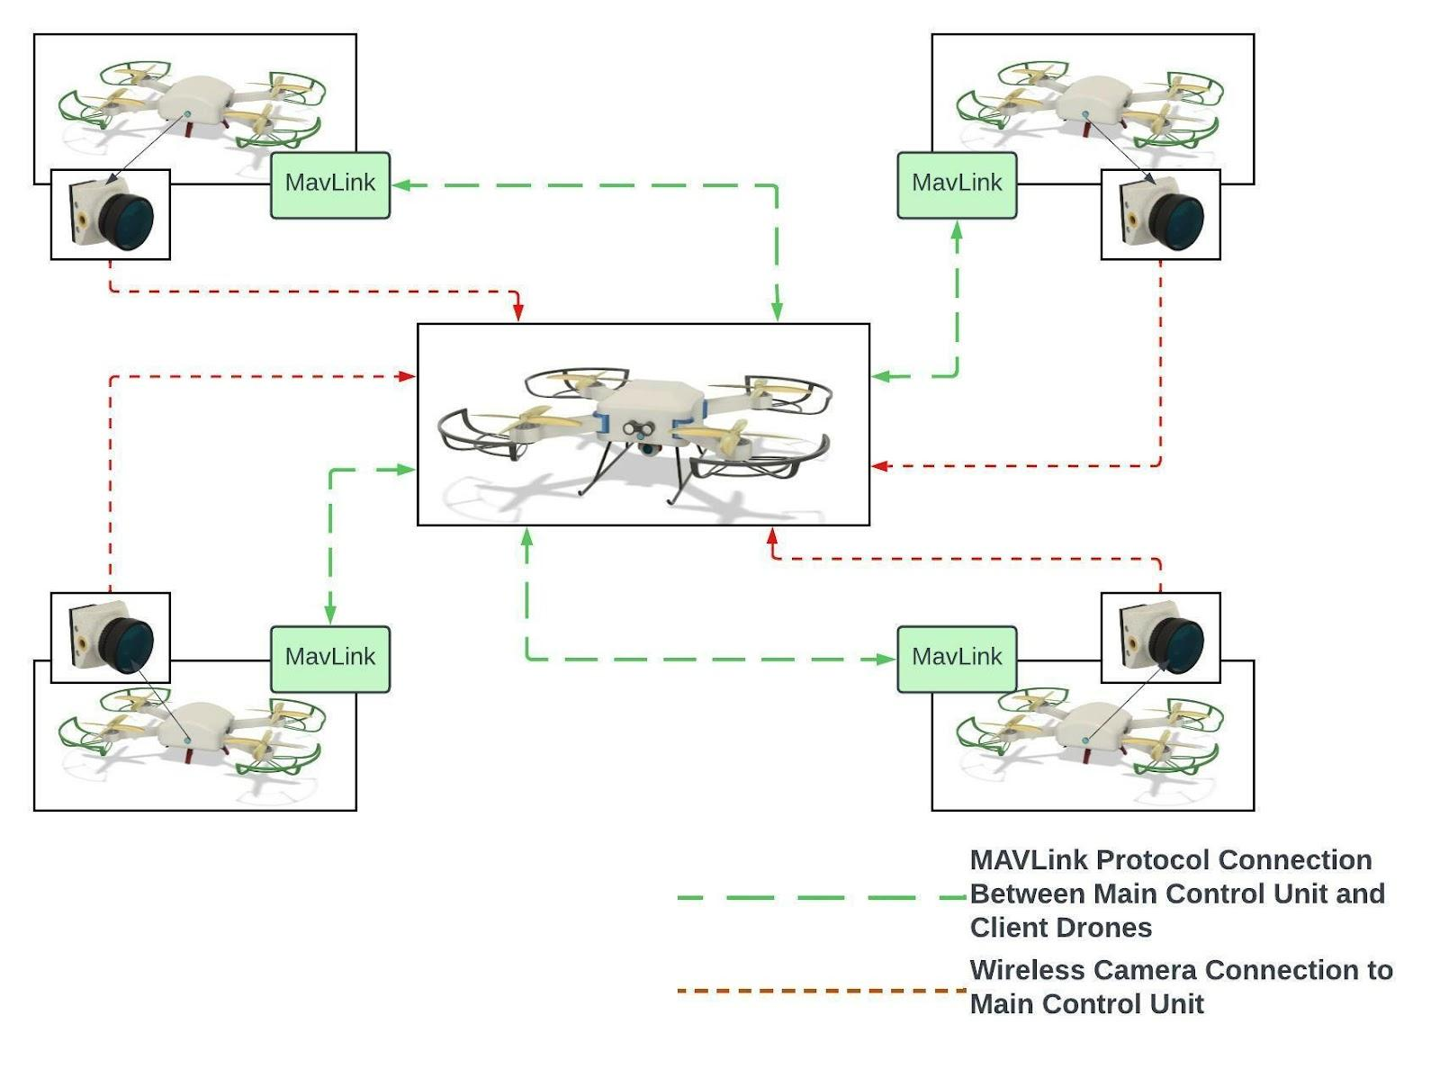
System Architecture
The System Architecture of the swarm drone project is designed to enable the coordinated and synchronized motion of drones. The drones consists of the following major components

Slide 11
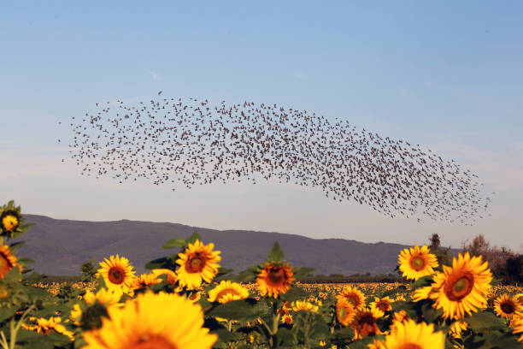
Swarm Algorithm
04

Slide 12
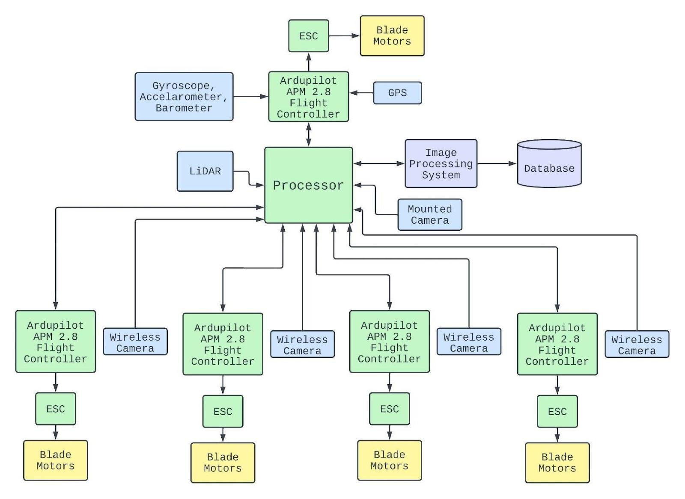
Communication
SWARM ALGORITHM
Coding
Each aerial robot is equipped with Esp8266 that enable them to exchange information with the control unit and other robots in the swarm. This communication facilitates coordination, information sharing, and consensus building.
To achieve coordinated motion, the robots employ advanced algorithms and techniques which we developed using libraries like Dronekit and Mavlink. The swarm algorithm determines the desired direction of motion for the entire swarm. This algorithm takes into account inputs from the control unit and feedback from individual robots to achieve consensus and maintain synchronized motion.

Slide 13

Major Components Used
05

Slide 14
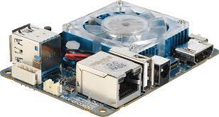
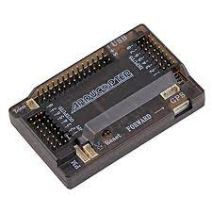
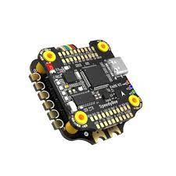
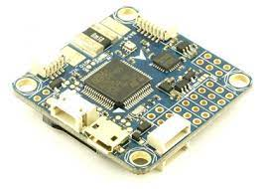
Odroid XU4
ELECTRIC COMPONENTS
Flight Controllers
The Odroid XU4 is a powerful single-board computer with an octa-core processor, 2 GB of RAM, and a Mali-T628 MP6 GPU. It offers various connectivity options, including Gigabit Ethernet, USB 3.0, and Wi-Fi. With its compact form factor, it is suitable for applications such as multimedia, gaming, servers, and IoT projects.
It is used as Main control unit for the Swarm Drones to gather, calculate and transfer the data over other drones.
A flight controller is the central component of a drone that manages its flight by processing sensor data, executing control algorithms, and adjusting motor outputs for stability and control. It incorporates sensors, a microcontroller, control algorithms, and communication interfaces.
Notes:
software description likhna he?

Slide 15
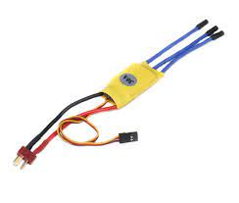
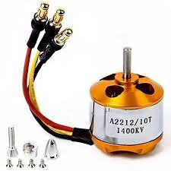
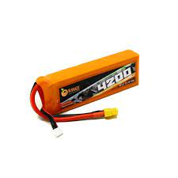
Electronic Speed Controller
ELECTRIC COMPONENTS
BLDC Motors
Batteries
An Electronic Speed Controller (ESC) is a device that controls the speed and direction of an electric motor. It receives signals from a flight controller and converts them into the appropriate power output for the motor.
BLDC Motors are used to generate the necessary thrust to control the movement of the drones. These motors can be connected with microcontroller via ESC.
The drones are powered by high-capacity batteries, supplying the required electrical energy for flight and operation. These batteries are designed for optimal power output and endurance, allowing the drones to operate for extended periods.

Slide 16

Software Used
06

Slide 17



Arduino IDE
SOFTWARE USED
STM32 Cube IDE
Fusion 360
Arduino IDE is used to compile and upload the code written in C++ language in the microcontrollers.
STM32 Cube IDE is used to compile and flash the firmware in flight controllers which were built by stm32
Fusion 360 is a cloud-based 3D computer-aided design (CAD) software developed by Autodesk. It is a comprehensive design and engineering tool that allows users to create, simulate, and fabricate 3D models for various purposes.

Slide 18



Mission Planner
SOFTWARE USED
VS Code
Ultimaker Cura
It is used to configure and calibrate the Ardupilot supported Flight controllers via MavLink Protocol
VS Code is used to write and execute the test codes in different coding languages.
Ultimaker Cura is used to convert 3D CAD Models into appropriate GCODE file to use it in 3D Printer.

Slide 19

Idea
Implementation
07

Slide 20
Design of the Drone in Fusion360
DESIGN
Communication
SETUP
Connections
IMPLEMENTATION
Coding
Mechanical Structure
ASSEMBLY
The drone frame to give structural support to the Components
The Drones are connected via WiFI Connection.
GPS - UART
QMC Magnetometer - I2C
ESP8266 - UART
Connected to Flight Controller
Python - Using Dronekit and Python Libraries C++ - To use NodeMCU as WiFI and use other functions
CSS / Java - To create Server test in HTML
3D Print and Joint the Structure parts using Bolts and Screws. Integrating the electrical components to the Frame.

Slide 21

Testing and Evaluation
08

Slide 22

Testing
Rigorous testing and evaluation were conducted to validate the performance of the swarm drone system.
Simulations and real-world experiments were performed to assess the swarm algorithm, communication protocols, and overall coordination capabilities.
The system's performance, synchronization, and response to different scenarios were evaluated.
The outcomes of the testing phase provided valuable insights for further improvements and optimizations.

Slide 23
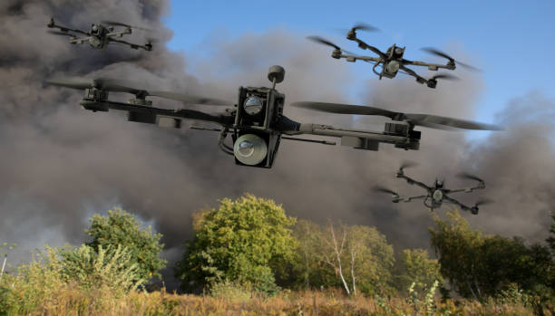
Future Applications
09

Slide 24
Applications
Search and rescue
Military operations
Swarm drones can assist in search and rescue missions by covering large areas quickly and efficiently. They can be equipped with thermal cameras and other sensors to detect heat signatures or locate missing individuals in remote or inaccessible areas.
Swarm drones have potential military applications, including surveillance, reconnaissance, and swarm-based attacks. They can provide enhanced situational awareness and perform coordinated missions in complex environments.
Agricultural Applications
Environmental Monitoring
Entertainment
Swarm drones can be used for precision agriculture, where they can monitor crops, spray fertilizers or pesticides precisely, and collect data for crop health analysis.
Swarm drones can monitor environmental conditions such as air quality, water quality, and wildlife population. By deploying a group of drones, they can provide comprehensive data and mapping of large areas in real-time.
Swarm drones can create mesmerizing light shows by synchronizing their movements and illuminating the sky with colorful LED lights. This application is often seen in entertainment events, concerts, and celebrations.

Slide 25

THANKS
Does anyone have any questions?

